Slide 1



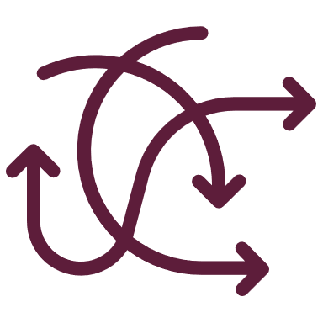


Managing resources: Analysis Paralysis from a BA perspective
By – Nassim Salehi and Ponmani Manoharan

Slide 2
Summary
Analysis Vs Analysis Paralysis
Paradox of choices
Ways to overcome Analysis Paralysis from BA’s perspective.
The BCG Matrix
Competitor Analysis
Driving Forces Analysis
Five Forces Industry Analysis
Product Life Cycle Analysis
Reference

Slide 3









Analysis Vs Analysis Paralysis
Analysis Paralysis is a mindset – Overthinking, and obsessing results in No-decision making
The analysis is finding values that can be used to interpret the data and derive meaning. | Analysis paralysis is the trouble faced when trying to over-analyse. This may occur when trying to verify a vast amount of data while trying to identify problems any trends or meaning.

Slide 4

Analysis Paralysis is a Killer of productivity
High pressure, anxiety-producing situations lead to lower performance on cognitively demanding tasks, and it affects the working memory.
Overthinking kills creativity
Take action and extinguish worry
Find appropriate tools that can aid in decision making

Slide 5
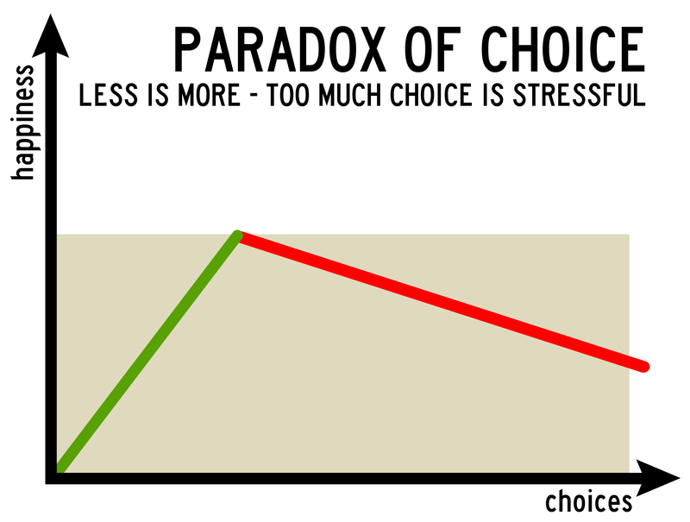
The paradox of Choices – less is more when it comes to engagement
Over Abundance of choices can lead to anxiety, indecision, paralysis and dissatisfaction.
A large selection of items with a variety of benefits and drawbacks makes it hard to choose an option.
Stopping people from choosing an option can cause people anxiety ,thus stalling decision-making process.
Even though the decision has been made, people may still stress whether they made the wrong decision.

Slide 6

Way to overcome Analysis paralysis from a BA perspective

Slide 7
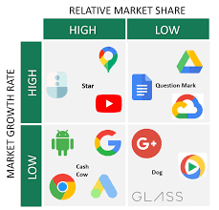
The BCG or share portfolio Matrix helps business analysts of organisations with multiple business products.
The BCG matrix allows a multi-business company to evaluate the merits of its individual business units or business lines to determine appropriate market strategies for each business.
The BCG Growth Matrix
Case study: Google as Viewed in a BCG Portfolio Planning Matrix
Google is a huge company with multiple products and services.
Business analysts at google might get caught in analysis paralysis when integrating information from multiple sources.
Use the analytical outputs of the BCG portfolio planning matrix to ensure the organization has enough stars to secure high growth, that it has enough cash cows to provide the funding for this future growth, and that it has enough question marks targeted with the potential to be turned into future stars.

Slide 8
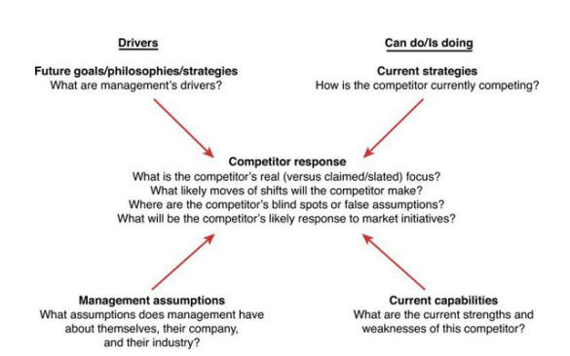
Competitor Analysis
The purpose of competitor analysis is to provide a comprehensive picture of the strengths and weaknesses of current and potential competitors to identify opportunities and threats for your organization. Competitor analysis has four main objectives:
• Identify competitors’ future and strategies.
• Predict competitors’ likely reactions to competitive initiatives.
• Determine the match between a competitor’s strategy and its capabilities.
• Understand a competitor’s weaknesses.
Case Study: Chinese Mobile Phone Market:
Android phone market in China is vast with hundreds of competitors.
The outcome of competitor analysis is the development of a response profile of possible moves that a competitor might make.
The vast competition in the market and different strategies in the Chinese market cause analysis paralysis.
Through competitor analysis, the new entrant profile includes both potential attacking and defensive moves.
The ultimate objective of competitor analysis is an improved ability to predict competitors’ behaviour—and even to influence that behaviour to a company’s advantage from the overwhelming data
Aiding in the decision-making process

Slide 9
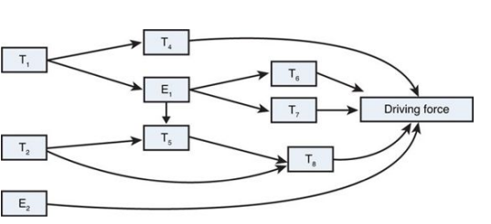
The drivers are clusters of trends that collectively influence changes to an industry’s structure and a rival’s competitive conduct.
Forces that push toward change are called driving or helping forces.
Forces that resist change are called restraining or hindering forces.
DFA plays a critical role in the larger strategy development process.
DFs indicate the external factors likely to have the greatest impact on a firm soon.
A firm must effectively address these forces if it is to achieve success.
Driving Forces Analysis
Case study: Driving forces in the digital music market.
DFA as applied to the digital music market as of the end of 2011 and the start of 2012.
The DFA helps you figure out which major DFs affect the digital music market and whether the forces indicate a more- or less-attractive industry environment from a profitability standpoint.
The analysis helped firms to understand that markets of digital music will be profitable for the short term if the firm can effectively add innovative features for their users.

Slide 10
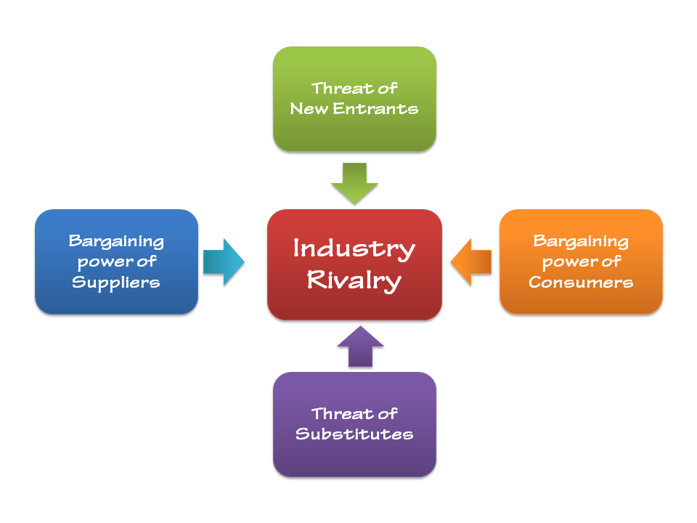
Five forces Industry Analysis
The purpose of industry analysis is to analyze the economic and market forces that will ultimately influence an industry’s profit potential.
It enables your organization to determine the attractiveness or profit potential of a focal industry by rigorously examining the interaction of five competitive forces.
Case study: Porter’s Five Forces: Olive and Sinclair Chocolate Company
The olive and Sinclair chocolate company used the five force model to evaluate their stand in the overwhelming marker of chocolate production.
Porter’s five force model reviled that
the competition in the industry is high
many opportunities are available for new entrants
the customers have high expectations towards fine tastes. Olive
Sinclair has built their brand around an old-fashioned, Southern approach to chocolate making, which adds to its competitiveness.

Slide 11
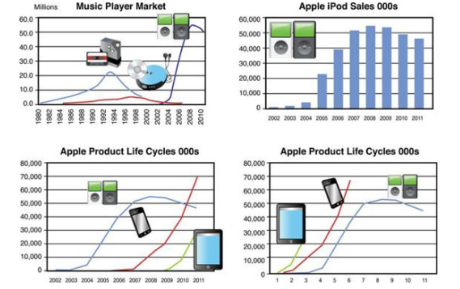
Product life cycle (PLC) analysis describes how sales of a product evolve as a function of time.
Product Life Cycle Analysis
Case Study: Apple’s Product Life Cycles and Growth Potential from the iPod to the iPad
The Apple product life cycles indicated just how big the iPhone and iPad will be over the next few years.
It took the iPod five years to break the 30 million units per year mark. The iPhone got there in four, and the iPad made it in two.
Overall, 67 million iPads have been sold.
It took Apple 24 years to sell as many Macs, five years to sell as many iPods, and three years to sell as many iPhones as possible

Slide 12
Reference
Bensoussan, B.E. and Fleisher, C.S. (2014). Analysis without paralysis : 12 tools to make better strategic decisions. Upper Saddle River, New Jersey: Pearson Education, Inc.
Gilbert, S. (2016). Analysis Paralysis is Not a Friend to Your Business. [online] Curatti. Available at: https://curatti.com/analysis-paralysis/.
Heck, B. (2021). Making Your Data Useful: Overcoming Data Analysis Paralysis. [online] www.ventivtech.com. Available at: https://www.ventivtech.com/blog/overcoming-big-data-analysis-paralysis-ventiv.
Kane, B. (2015). The Science of Analysis Paralysis & Why It Kills Productivity. [online] Ambition & Balance. Available at: https://blog.doist.com/analysis-paralysis-productivity/.
Pignatiello, G.A., Martin, R.J. and Hickman, R.L. (2018). Decision fatigue: A conceptual analysis. Journal of Health Psychology, 25(1), p.135910531876351. doi:10.1177/1359105318763510.
SCHWARTZ, B. (2007). The Paradox of Choice. HarperCollins Publishers.
Tugend, A. (2010). The Paralyzing Problem of Too Many Choices. The New York Times. [online] 26 Feb. Available at: https://www.nytimes.com/2010/02/27/your-money/27shortcuts.html.

